Slide 1
How Astronomy Shaped The Modern Civilization & How To Find Direction Using The Stars
Teja Teppala
University of Missouri

Slide 2
About me:
I AM TEJA TEPPALA
Hometown: Visakhapatnam (Vizag), India.
BS – MS in Physics from University of Hyderabad, India.
Currently working on a PhD in Physics/Astrophysics.
I study evolution of galaxies. More specifically, I study what triggers/stops star formation in galaxies.

Slide 3


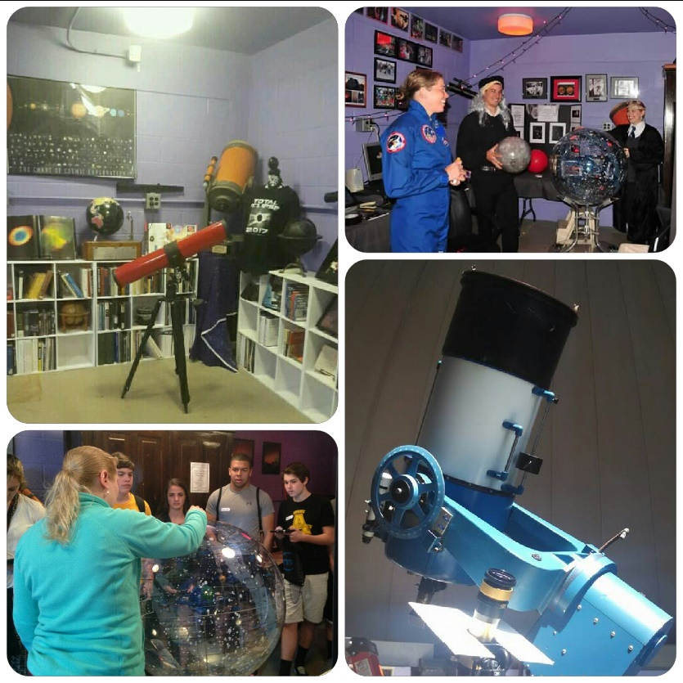

3

Slide 4
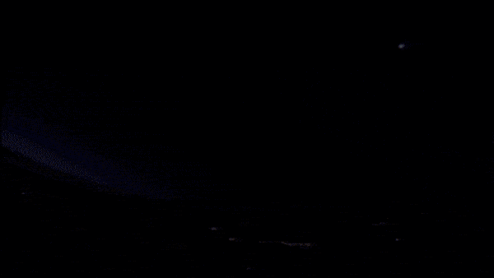
Why does the Sun rise and set?

Slide 5
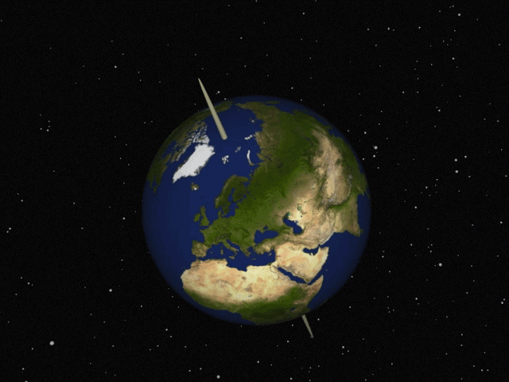
Why does the Sun rise and set?
Answer: The Sun appears to
rise and set because the
Earth is spinning (rotating)
about its own axis!

Slide 6
The sky is moving too!
The Sun is not the only star to rise and set every day.
From the surface of the Earth, it appears as if the sky is rotating around us.

Slide 7
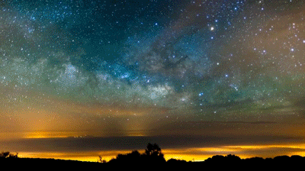
The sky is moving too!

Slide 8
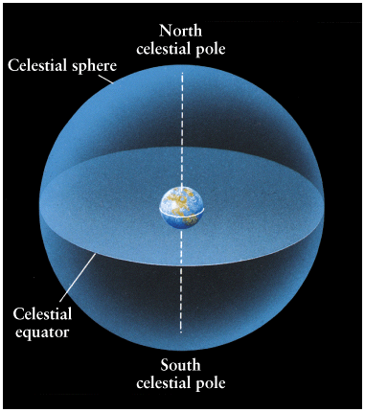
The celestial sphere
Everything we see in the sky (above the clouds) can be mapped on what we call: “The Celestial Sphere”.
The equator and poles of the Earth match those of the celestial sphere.

Slide 9
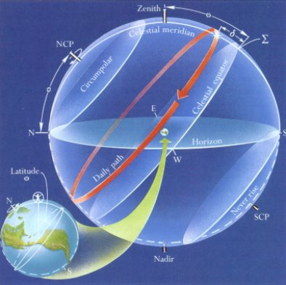
Circumpolar stars
Depending on your location on the Earth, some stars will never rise and set.
These stars are called “Circumpolar stars”.

Slide 10
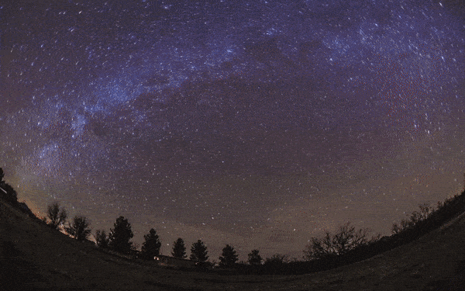
Circumpolar stars

Slide 11
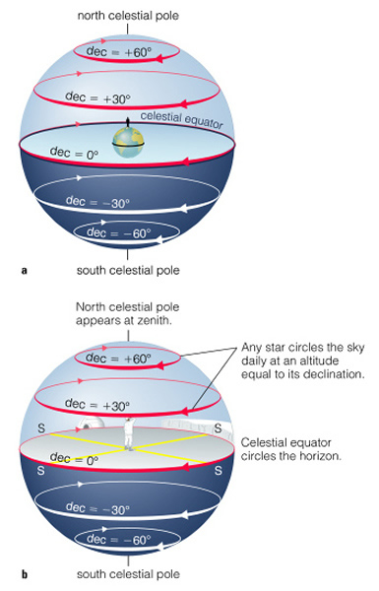
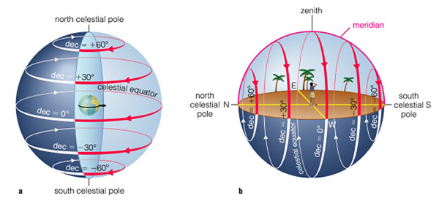
Circumpolar stars
If you are at the North/South pole, all stars are circumpolar.
If you are on the equator, none of the stars are circumpolar.

Slide 12
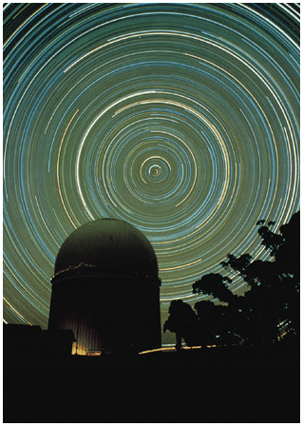
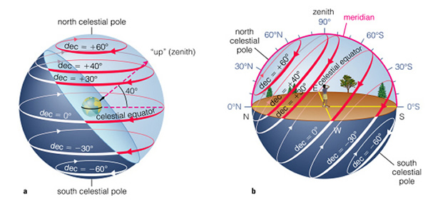
Circumpolar stars
There is a star which is nearly on the North Celestial Pole: Polaris (“The North Star”).

Slide 13
Constellations!
Constellations are areas on the celestial sphere in which a group of stars forms a perceived pattern, such as an animal, mythological person, or an object, etc.
How many constellations are there in the night sky?

Slide 14
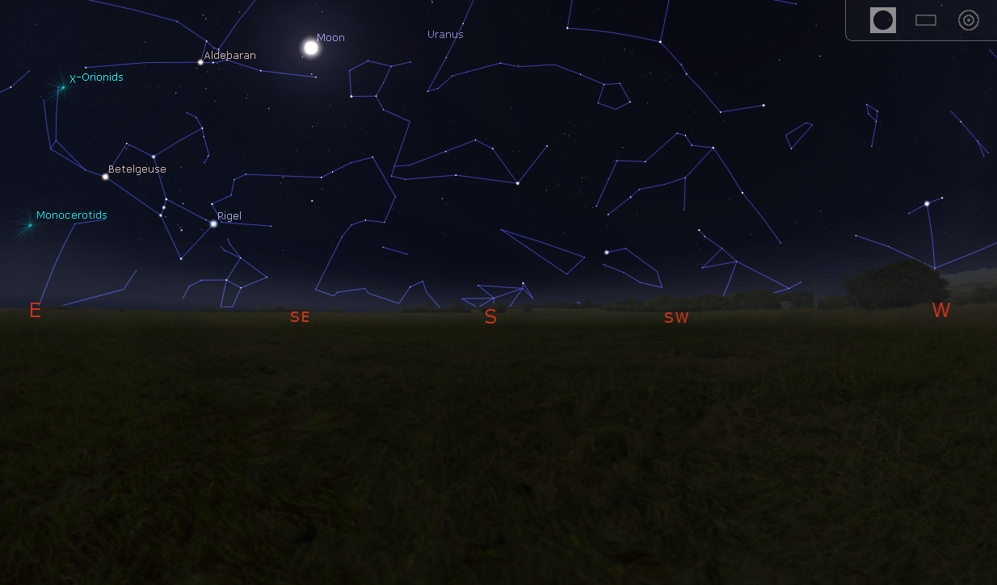
Constellations!
There are 88 constellations!
There are 88 constellations!

Slide 15
Using constellations in agriculture:
People noticed that these patterns are visible only at certain times.
Before there were proper calendars, these constellations helped determine when to sow, and harvest.

Slide 16
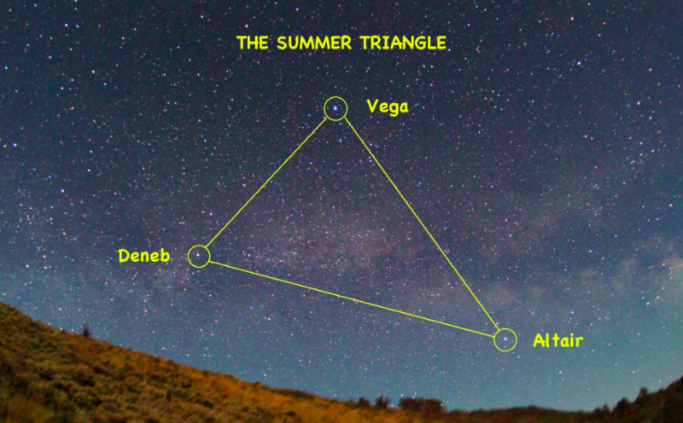
Using constellations in agriculture:
If one could see the “Summer triangle” overhead, then they could determine that Summer is coming along.

Slide 17
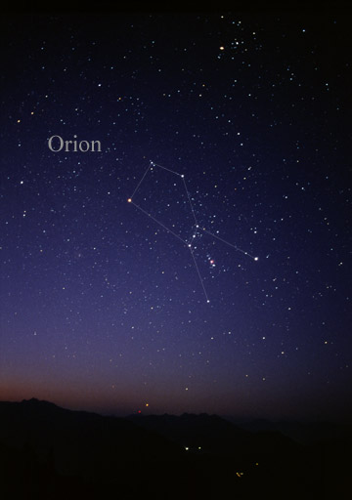
Using constellations in agriculture:
If the Orion constellation started to become fully visible, they would know winter was coming soon.

Slide 18
Why was astronomy key to modern civilization?
This ability to predict seasons led to hunting and gathering being replaced by agriculture…
…which in turn led to formation of large societies, cities and kingdoms…
…along came the governments, industries and new technologies born out of necessities, and the rest is history!

Slide 19
Using stars for navigating:
Remember Polaris, the “North Star”?

Slide 20
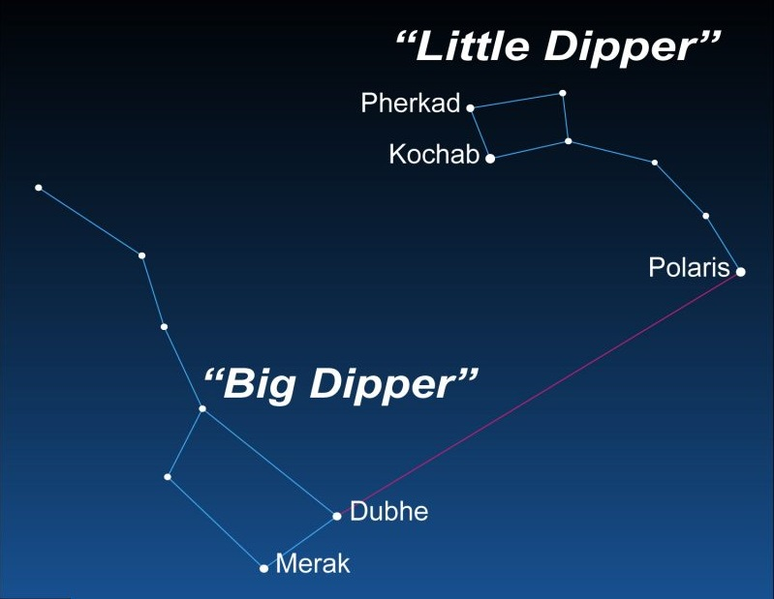
Locating the “North star”

Slide 21
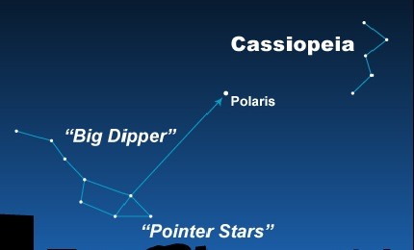
When Big Dipper is obscured, we can use Cassiopeia, on the other side of Polaris:

Slide 22
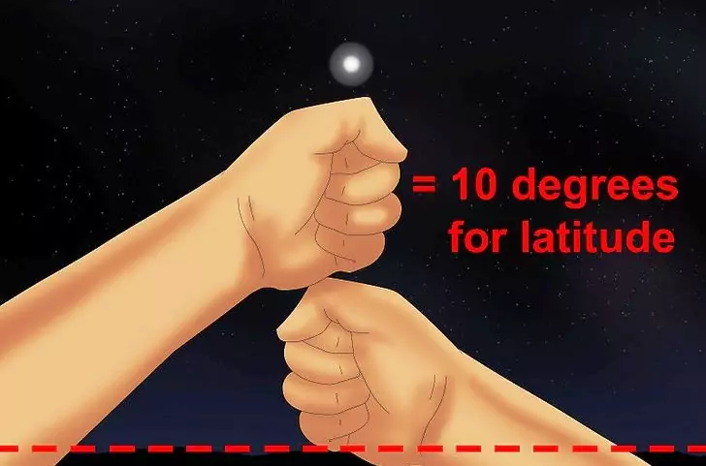
Added bonus - finding your latitude:

Slide 23
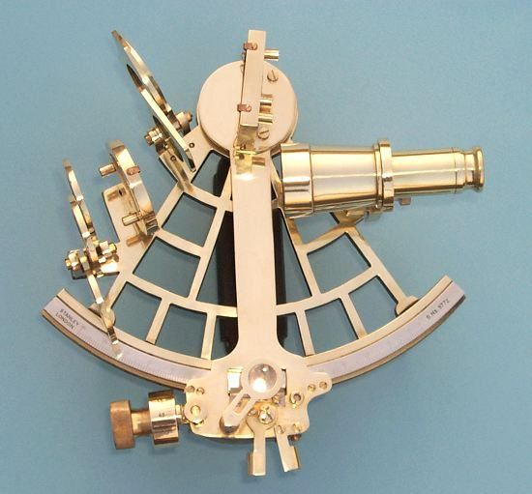
Using stars for navigating:
Early sea explorers relied on the North Star for directions and staying on course.
In modern times, 57 navigational stars along with Polaris are used. Their positions are listed in nautical almanacs. A sextant is used for accurate measurement.

Slide 24
Alas, you can’t find Polaris once you cross the equator into southern hemisphere!
What to do?

Slide 25

Alas, you can’t find Polaris once you cross the equator into southern hemisphere!
What to do?

Slide 26
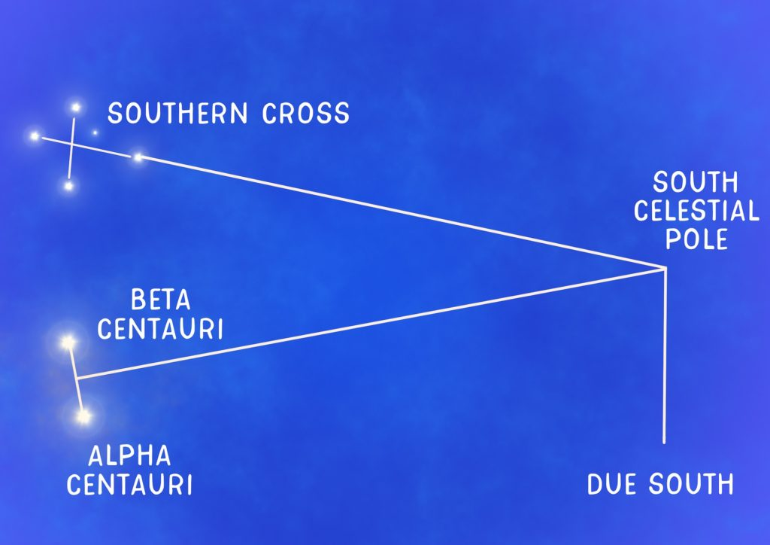
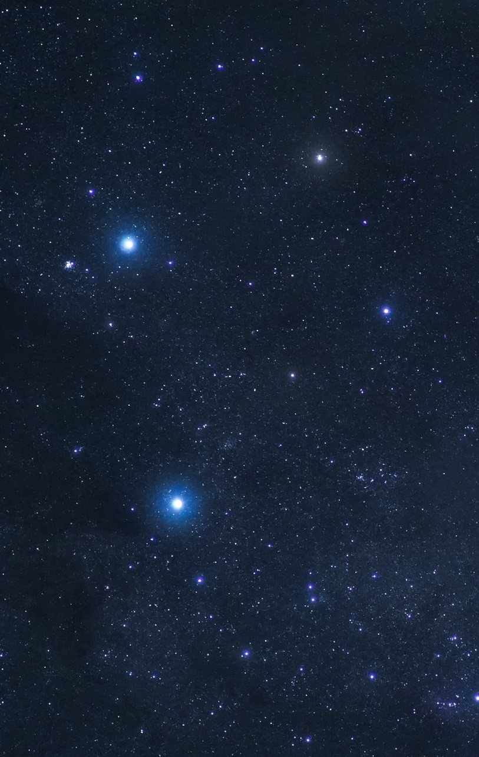
We use “Crux”, a.k.a. the “Southern Cross”

Slide 27
What if you can’t find any of these stars?
(Most of the) stars will always rise in the East and set in the West.
We can use this motion of stars to find directions!

Slide 28
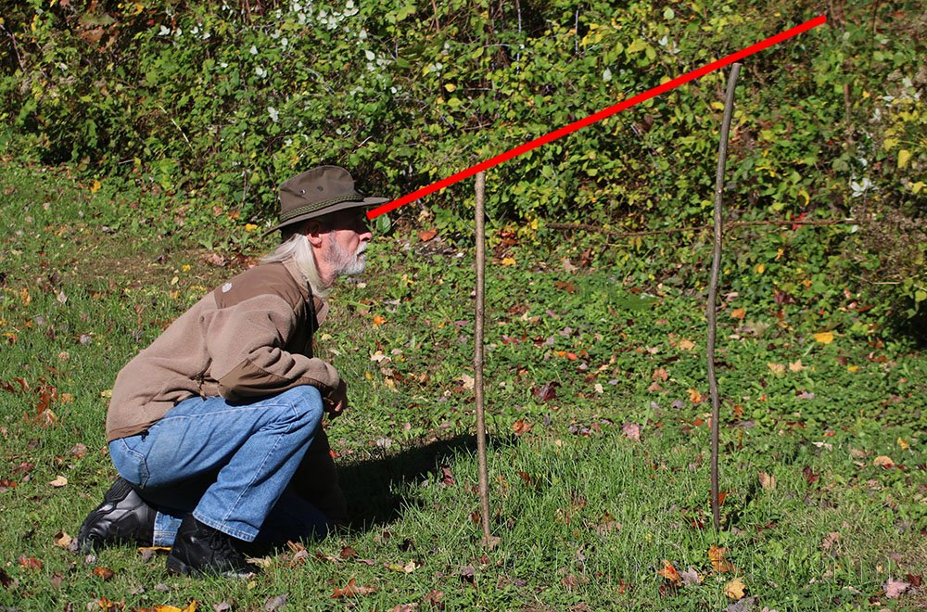
How to do it:
Drive two stakes to the ground, spaced about a yard apart, with the taller stake behind a smaller one.

Slide 29
How to do it:
Pick a bright star so that it lines up with the tops of both stakes.

Slide 30
How to do it:
Now wait for 10-15 minutes and check how the star moved with respect to the tops of the stakes.
If the star moved up, you are facing East.
If the star moved down, you are facing West.
If the star moved to the left, you are facing North.
If the star moved to the right, you are facing South.

Slide 31
So, there you have it: a brief guide to navigating using stars; wherever you are in the world, you now know how to find North, South, East and West! Now, go ahead and explore!

Slide 32
Thanks!
ANY QUESTIONS?

